Slide 1
Graph Theory
Isomorphic graphs

Slide 2

Handshaking Theorem
Handshaking Theorem is also known as Handshaking Lemma or Sum of Degree Theorem.
Handshaking Theorem states in any given graph, Sum of degree of all the vertices is twice the number of edges contained in it.
The following conclusions may be drawn from the Handshaking Theorem.
In any graph,
The sum of degree of all the vertices is always even.
The sum of degree of all the vertices with odd degree is always even.
The number of vertices with odd degree are always even.

Slide 3
Question:
A simple graph G has 24 edges and degree of each vertex is 4. Find the number of vertices.
Solution:
Given,
Number of edges = 24
Degree of each vertex = 4
Let number of vertices in the graph = n
Using Handshaking Theorem, we have- Sum of degree of all vertices = 2 x Number of edges
Substituting the values, we get : n x 4 = 2 x 24
n = 2 x 6
∴ n = 12
Thus, Number of vertices in the graph = 12.

Slide 4
Q. 2. A graph contains 21 edges, 3 vertices of degree 4 and all other vertices of degree 2. Find total number of vertices.
Solution:
Given-
Number of edges = 21
Number of vertices with degree 4 = 3
All other vertices are of degree 2
Let number of vertices in the graph = n.
Using Handshaking Theorem, we have-
Sum of degree of all vertices = 2 x Number of edges
3 x 4 + (n-3) x 2 = 2 x 21
12 + 2n – 6 = 42
2n = 42 – 6
2n = 36
∴ n = 18
Thus, Total number of vertices in the graph = 18

Slide 5
Q. 3 A simple graph contains 35 edges, four vertices of degree 5, five vertices of degree 4 and four vertices of degree 3. Find the number of vertices with degree 2.
Given-
Number of edges = 35
Number vertices with degree 5 = 4
Number of vertices with degree 4 = 5
Number of vertices with degree 3 = 4
Let number of vertices with degree 2 in the graph = n.
Using Handshaking Theorem, we have-
Sum of degree of all vertices = 2 x Number of edges
4 x 5 + 5 x 4 + 4 x 3 + n x 2 = 2 x 35
20 + 20 + 12 + 2n = 70
2n = 70 – 52
2n = 18
∴ n = 9

Slide 6
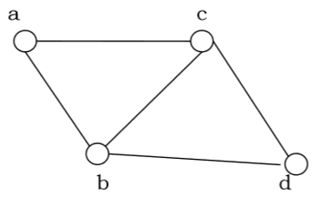
Planar Graph-
In graph theory, Planar graph is a graph that can be drawn in a plane such that none of its edges cross each other.

Slide 7
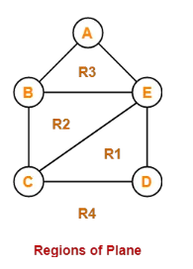
The following graph is an example of a planar graph-
Here, this planar graph splits the plane into 4 regions- R1, R2, R3 and R4

Slide 8
Euler’s Formula
If G is a connected planar simple graph with ‘e’ edges, ‘v’ vertices and ‘r’ number of regions in the planar representation of G, then-
r = e – v + 2
This is known as Euler’s Formula.

Slide 9
Question 1
Let G be a connected planar simple graph with 25 vertices and 60 edges. Find the number of regions in G.
Solution-
Given-
Number of vertices (v) = 25
Number of edges (e) = 60
By Euler’s formula, we know r = e – v + 2.
Number of regions (r)
= 60 – 25 + 2
= 37
Thus, Total number of regions in G = 37.

Slide 10
Question 2
Let G be a connected planar simple graph with 20 vertices and degree of each vertex is 3. Find the number of regions in G.
Solution-
Given-
Number of vertices (v) = 20
Degree of each vertex = 3
Calculating Total Number Of Edges (e): By sum of degrees of theorem, we have-
Sum of degrees of all the vertices = 2 x Total number of edges
Number of vertices x Degree of each vertex = 2 x Total number of edges
20 x 3 = 2 x e ➔ e = 30
Calculating Total Number Of Regions (r)
By Euler’s formula, we know r = e – v + 2.
Number of regions (r)
= 30 – 20 + 2
= 12
Thus, Total number of regions in G = 12.

Slide 11
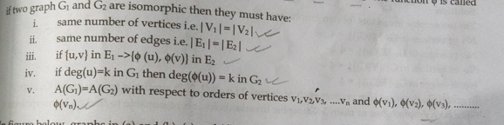
Isomorphic graphs
A graph can exist in different forms having the same number of vertices, edges, and also the same edge connectivity. Such graphs are called isomorphic graphs.
Conditions for being Isomorphic:

Slide 12
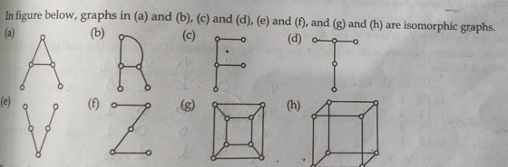
Example

Slide 13
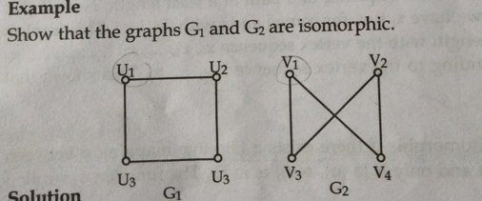

Slide 14
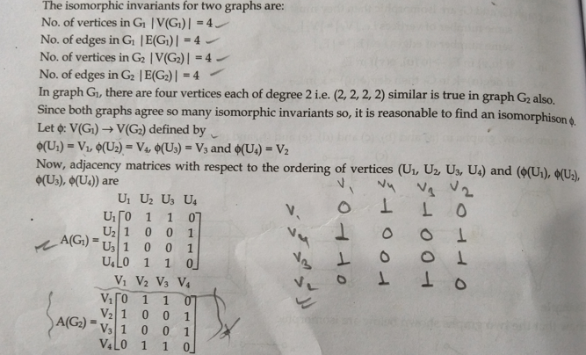

Slide 15
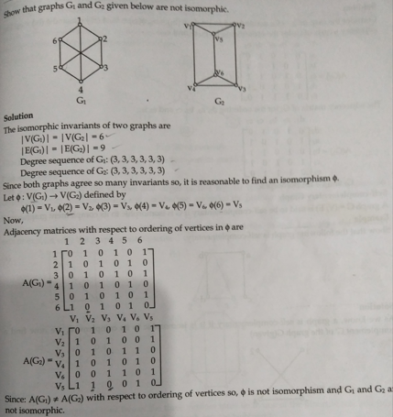

Slide 16
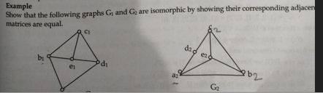

Slide 17
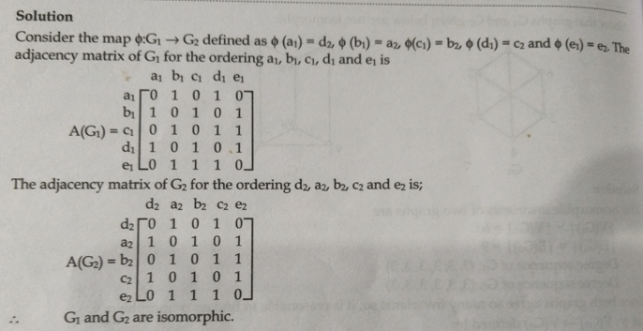

Slide 18
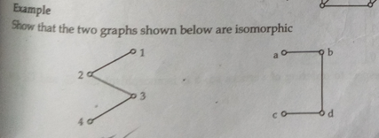
Example

